Slide 1

CODE NOW
Dilna p s

Slide 2
RELEVANCE OF TOPIC
In this digital era there are various digitization is happening like the AI is deploying so fast, various automations are happening and taking place of human and reducing the efforts of human. And all this things are happening because of programmers/developers they are doing a very hard work for the development of technology. As effect of this many developers/programmers are facing various physical / mental disorders like stress, carpel tunnel syndrome and more problems. So here developing a system which will reduce their injuries or problems like this by creating solution i.e. they have to just speak they want code the system will take it and create proper code .
The Voice translator can translate voice input and give translated voice output generated from it. It is created using google’s googleTrans API and speech_recognition library of python.

Slide 3
Description of project
This project aims to display the python code according to the users instruction through voice. We will be using machine learning concept in which voice will be recognized by using the natural language processing and will be printed on the editor. Firstly, users speech convert to text and code according to the text is matched, and print on editor.
Also print translated text in the editor.

Slide 4
OBJECTIVES OF THE STUDY
Users do not need to know the syntax
Programmers with beginner level can effectively use
No need to type the code
Users just need to know the logic
Users can easily translate voice to major languages

Slide 5
Existing System and Proposed System
There are lots of AI based speech recognition applications like Google Alexa, Apple Siri etc are available. But there are not many applications that convert users speech to code. This is not just a speech to text convert application. The user just need to give the instruction. Users are not necessary to know the syntax. And the proposed system helps to do both voice translation and voice to code conversion in a single platform.

Slide 6
Modules
Voice to code convertion
UI designing
Voice recognition
Matching keywords and print on the Editor
Voice Translation

Slide 7
Diagram
compare
Voice Commands
Speech to text
Print code
match
No
Print code is not available

Slide 8
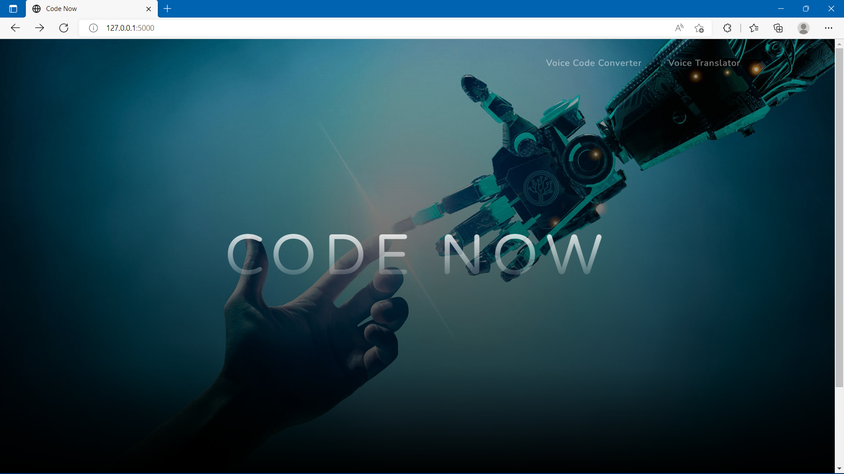
SCREENSHOTS

Slide 9
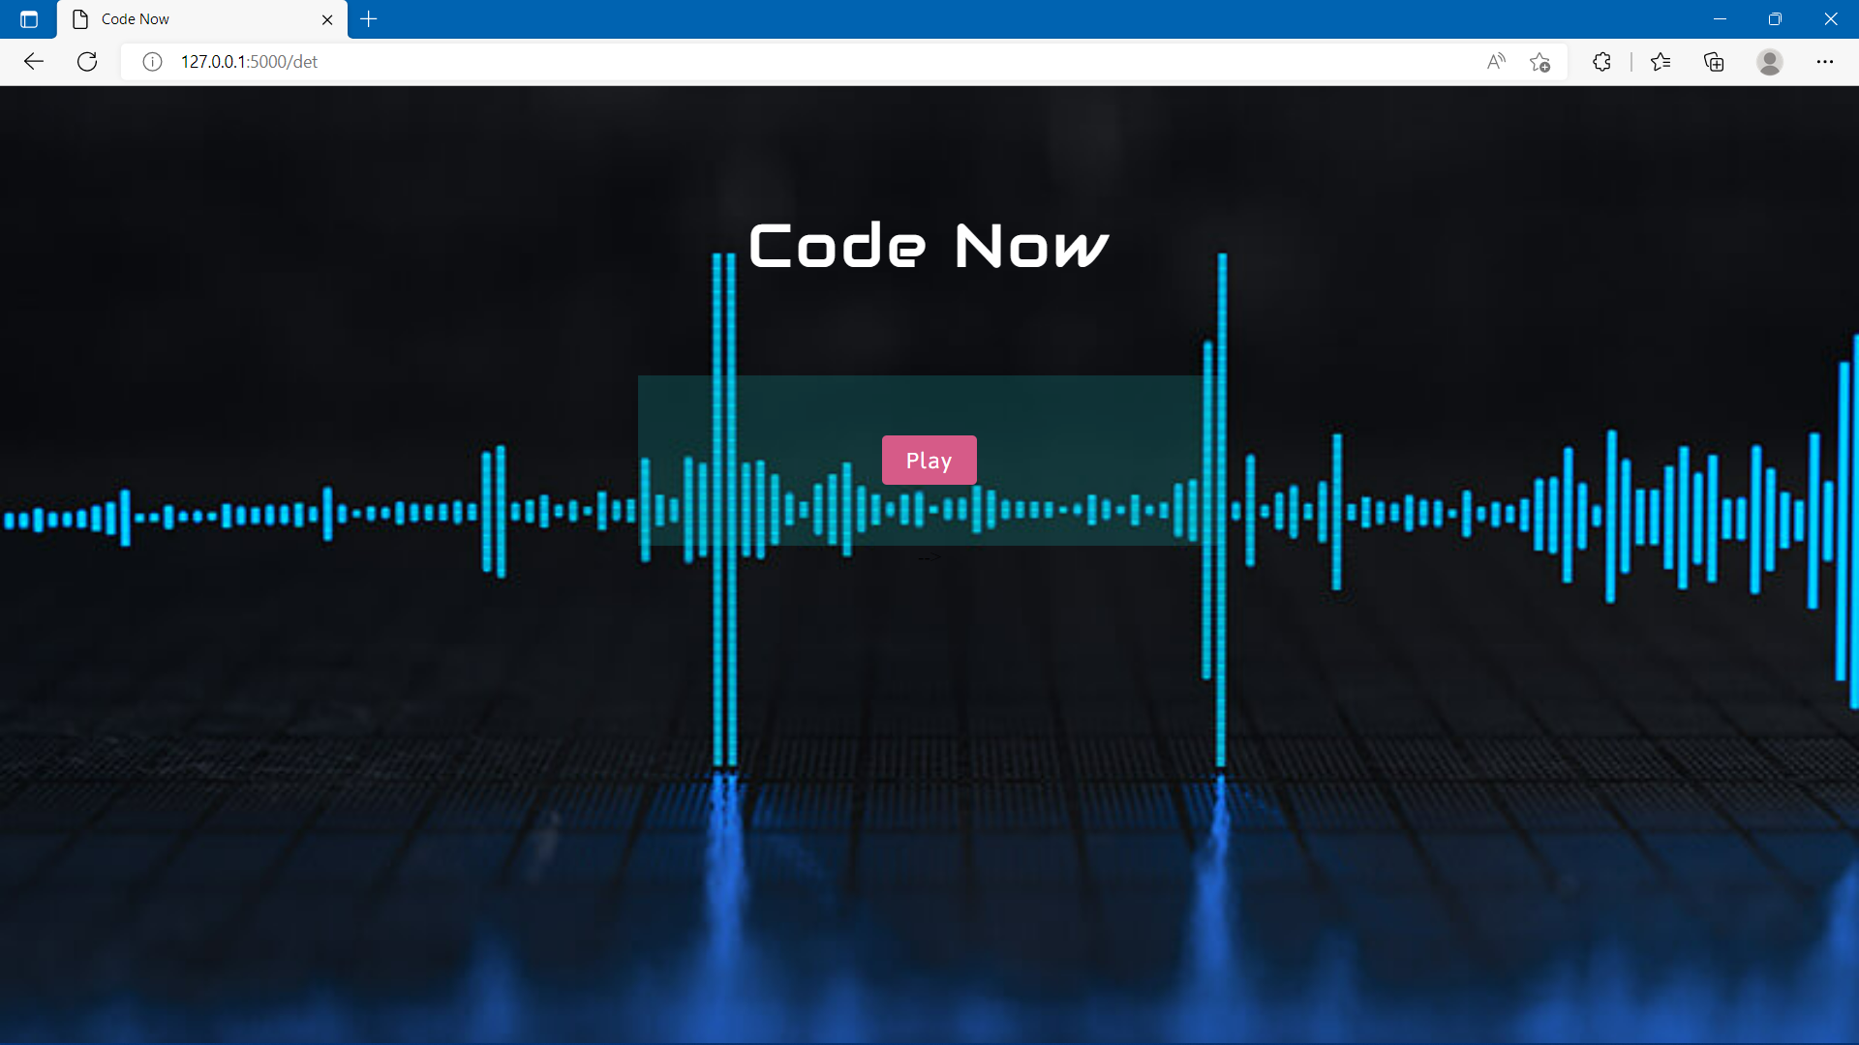

Slide 10
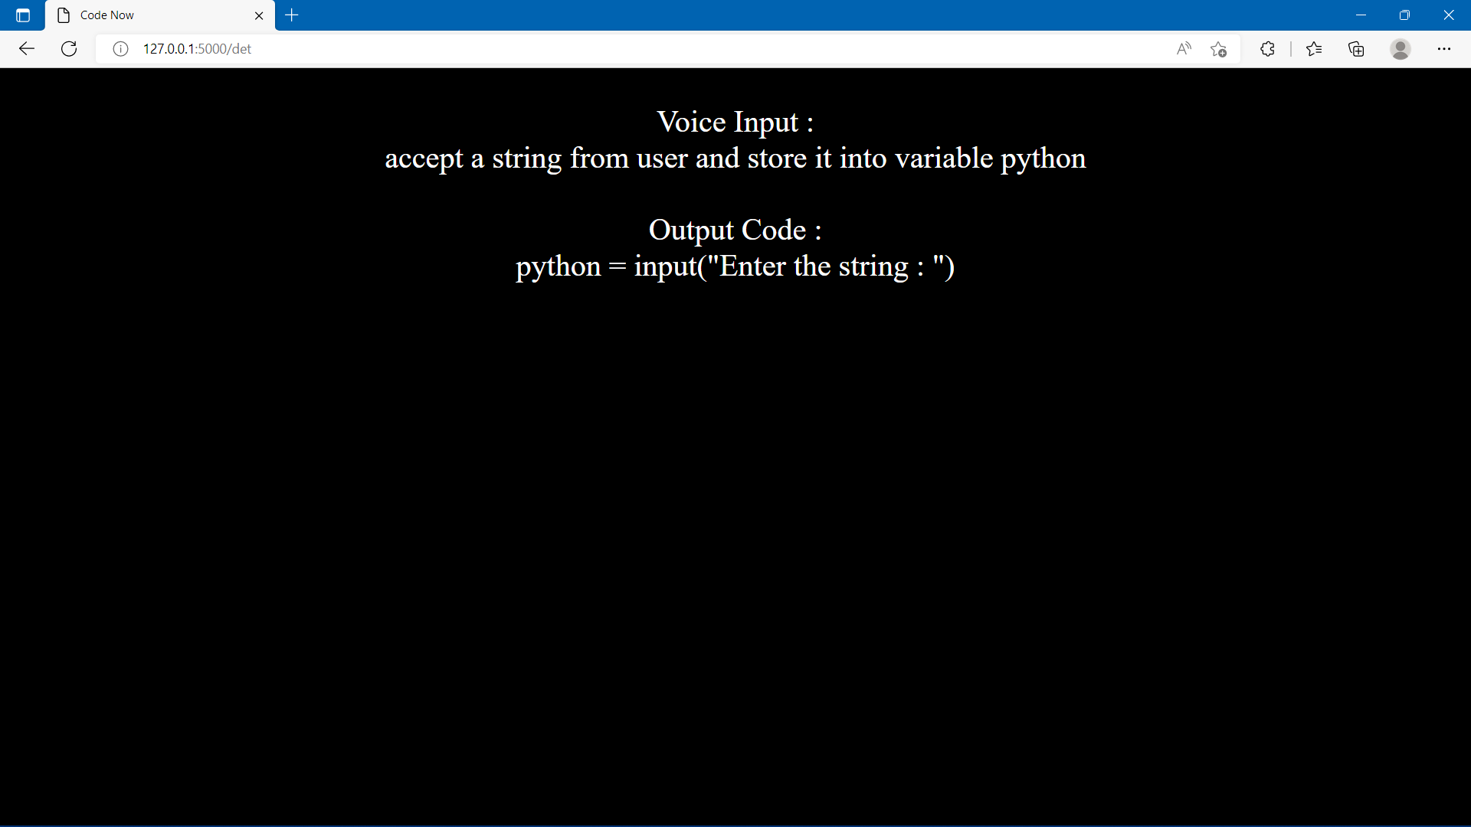

Slide 11


Slide 12


Slide 13
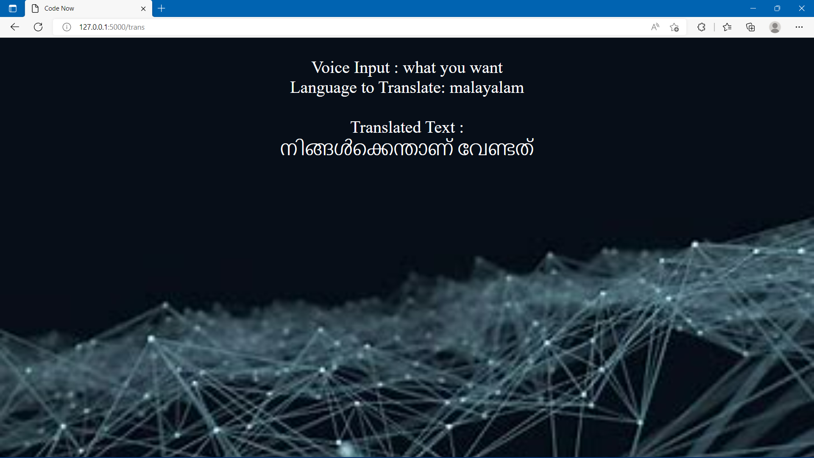

Slide 14
THANK YOU

